Slide 1
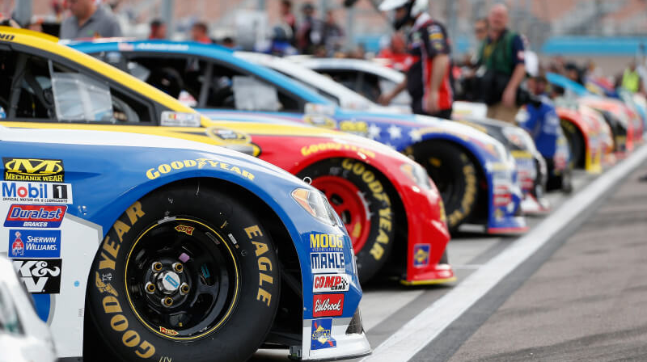
Car Price Prediction
Car Price Prediction using Linear Regression

Slide 2
ABSTRACT
A car price prediction has been a high interest research area, as it requires noticeable effort and knowledge of the field expert. Considerable number of distinct attributes are examined for the reliable and accurate prediction. To build a model for predicting the price of used cars in Bosnia and Herzegovina, we applied three machine learning techniques (Artificial Neural Network, Support Vector Machine and Random Forest). However, the mentioned techniques were applied to work as an ensemble. The data used for the prediction was collected from the web portal autopijaca.ba using web scraper that was written in PHP programming language. Respective performances of different algorithms were then compared to find one that best suits the available data set. The final prediction model was integrated into Java application. Furthermore, the model was evaluated using test data and the accuracy of 87.38% was obtained.

Slide 3
INTRODUCTION
Car price prediction is a fascinating and increasingly popular problem. According to data sourced from the Agency for Statistics of Bosnia and Herzegovina, there were 921,456 vehicle registrations in 2014, with 84% of them being personal cars. This number had increased by 2.7% since 2013, and this upward trend is expected to continue, making car price prediction all the more crucial.
Accurate car price prediction demands expert knowledge because prices are influenced by a multitude of distinctive factors. The most significant ones typically include the make and model, age, horsepower, and mileage. Fuel type and fuel consumption per mile also play a substantial role, given the fluctuating prices of fuel. Additionally, features such as exterior colour, number of doors, transmission type, dimensions, safety features, air conditioning, interior amenities, and the presence of navigation systems all contribute to a car's price.
In this study, we employ various methods and techniques to enhance the precision of used car price prediction, recognizing the complex interplay of these factors in determining a car's market value.

Slide 4
OBJECTIVE
To build a model for predicting the price of used cars in Bosnia and Herzegovina, we applied three machine learning techniques (Artificial Neural Network, Support Vector Machine and Random Forest). However, the mentioned techniques were applied to work as an ensemble. The data used for the prediction was collected from the web portal autopijaca.ba using web scraper that was written in PHP programming language.

Slide 5
Proposed System
In this system we are implementing effective car price prediction system using logistic regression. We can give the input as in CSV file or manual entry to the system. After taking input the algorithms applied. After accessing data set the operation is performed and effective results are obtained.

Slide 6
METHODOLOGIES
Data Collection
Data Pre-processing
Model Building
Evaluation

Slide 7
METHODOLOGIES
Data Collection
To build and develop Machine Learning models, you must first acquire the relevant dataset. This dataset will be comprised of data gathered from multiple and disparate sources which are then combined in a proper format to form a dataset. Dataset formats differ according to use cases. For instance, a business dataset will be entirely different from a medical dataset. While a business dataset will contain relevant industry and business data, a medical dataset will include healthcare-related data.
Data Pre-processing
In data pre-processing, it is pivotal to identify and correctly handle the missing values, failing to do this, you might draw inaccurate and faulty conclusions and inferences from the data. Needless to say, this will hamper your ML project.

Slide 8
METHODOLOGIES
Model Building
The model building process involves setting up ways of collecting data, understanding and paying attention to what is important in the data to answer the questions you are asking, finding a statistical, mathematical or a simulation model to gain understanding and make predictions, In these we use 80% of data for training and remaining 20 % of data for testing
Evaluation
The algorithm was applied on the whole dataset, to test how accurately the classifier can categorize samples into cheap, moderate and expensive car classes. It is a meta estimator that fits a number of decisions on various subsamples of the dataset and use averaging to improve the predictive accuracy and control over-fitting,

Slide 9
TECHNIQUE USED OR ALGORITHM USED
Machine Learning Classifiers in the Research
Classifier Models Tested
Random Forest (RF)
Artificial Neural Network (ANN)
Support Vector Machine (SVM)

Slide 10
TECHNIQUE USED OR ALGORITHM USED
Machine Learning Classifiers in the Research
Single Machine Learning Classifier Approach
Data Set Split: Training and Testing
Classifier Models Tested
Artificial Neural Network (ANN)
Random Forest (RF)
Support Vector Machine (SVM)
Random Forest (RF)
RF Application in Classification and Regression
Artificial Neural Network (ANN)
Emulating Human Brain Function Artificial Neurons and Weighted Matrices
Support Vector Machine (SVM)
Versatility in Solving Problems Binary Decision Making
Handling Unlabelled Data with Support Vector Clustering (SVC)

Slide 11
SYSTEM ARCHITECTURE
Data collection
Data preprocessing
Categorization with linear regression
Prediction
Cheap
expensive
moderate

Slide 12
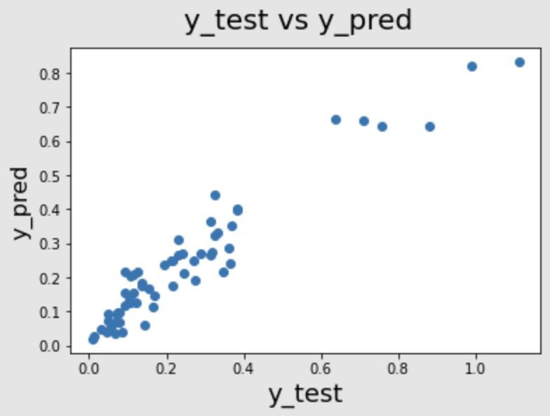
OUTPUT
The car price prediction model is able to make accurate predictions on average, with an R-squared value of 0.8 and a mean squared error of 10.000. However, the model may overestimate the prices of cars at the lower end of the price spectrum and underestimate the prices of cars at the higher end of the price spectrum.

Slide 13
CONCLUSION
Car price prediction can be a challenging task due to the high number of attributes that should be considered for the accurate prediction. The major step in the prediction process is collection and preprocessing of the data
scripts were built to normalize, standardize and clean data to avoid unnecessary noise for machine learning algorithms.
Data cleaning is one of the processes that increases prediction performance, yet insufficient for the cases of complex data sets as the one in this research. Applying single machine algorithm on the data set accuracy was less than 50%. Therefore, the ensemble of multiple machine learning algorithms has been proposed and this combination of ML methods gains accuracy of 92.38%. This is significant improvement compared to single machine learning method approach. However, the drawback of the proposed system is that it consumes much more computational resources than single machine learning algorithm.

Slide 14

THANK YOU!

